Slide 1
Prediction on Ticket Booking
Presented By:
Gourav Pratap

Slide 2
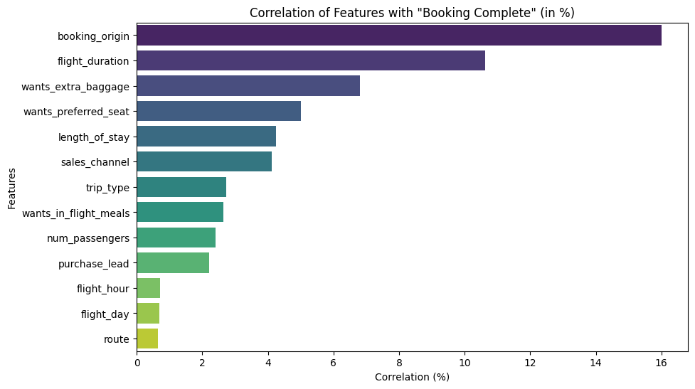
Dependency of the booking decision on other variables and the probability of booking based on different classifiers.
Classifier | Accuracy | Precision | Recall | F1 Score | Book Percentage (%) | Not Book Percentage (%)
Decision Tree | 0.7787 | 0.28171531 | 0.31959459 | 0.29946186 | 16.79 | 83.21
Random Forest | 0.8543 | 0.53898305 | 0.10743243 | 0.17915493 | 2.95 | 97.05
SVM | 0.852 | 1 | 0 | 0 | 0 | 100
K-Nearest Neighbors | 0.8312 | 0.3429003 | 0.15337838 | 0.21195145 | 6.62 | 93.38
Naive Bayes | 0.8245 | 0.29809104 | 0.13716216 | 0.18787598 | 6.81 | 93.19
Gradient Boosting | 0.8541 | 0.64383562 | 0.03175676 | 0.06052801 | 0.73 | 99.27
XGBoost | 0.851 | 0.48595506 | 0.11689189 | 0.18845316 | 3.56 | 96.44

